Slide 1
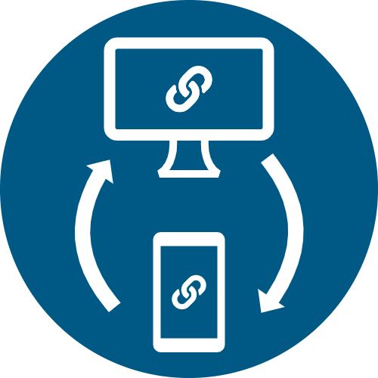
Lineker mobile
© Felip’s Tudio

Slide 2
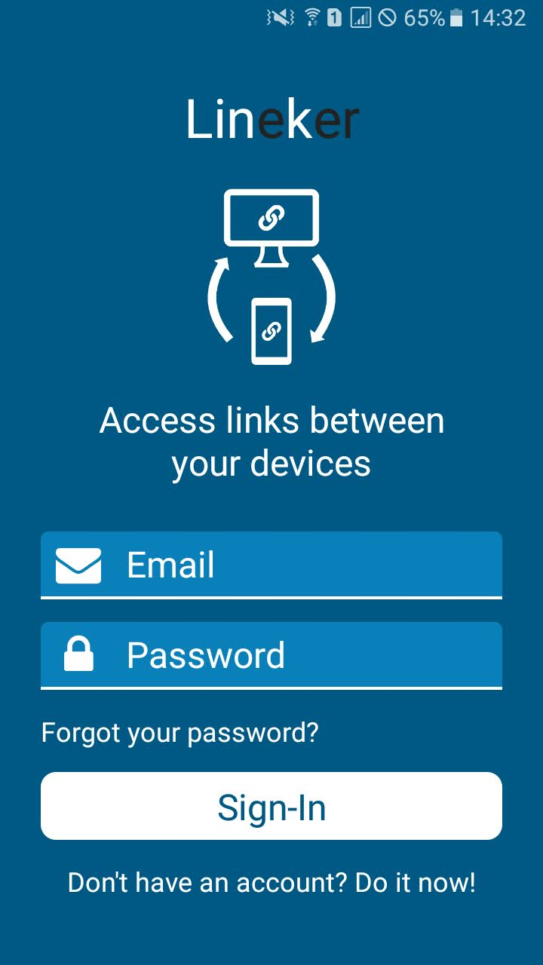
Dismiss keyboard on touch
Email input
Password input
Sends an email to reset user’s password
Sign up with email and password*
Sign in with email and password
* And creates the initial data in the database

Slide 3
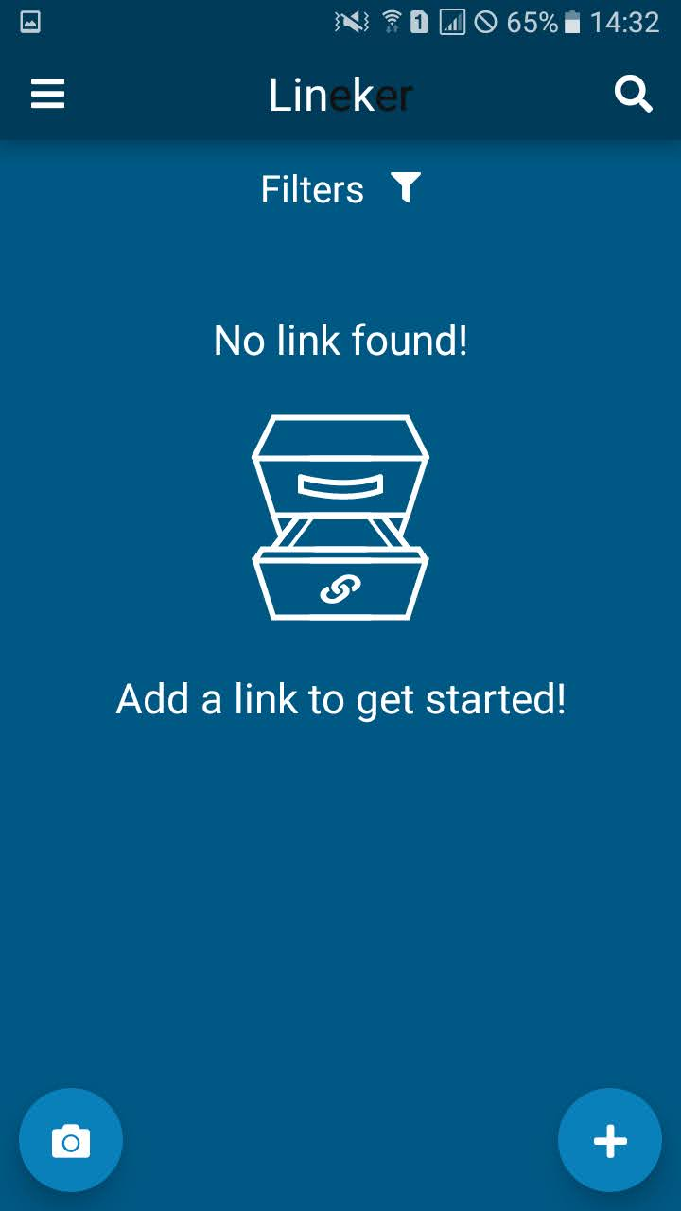
Open drawer
Open search header
Dismiss keyboard on touch
Navigates to Filters screen
Navigates to Scanner screen
Open add modal

Slide 4
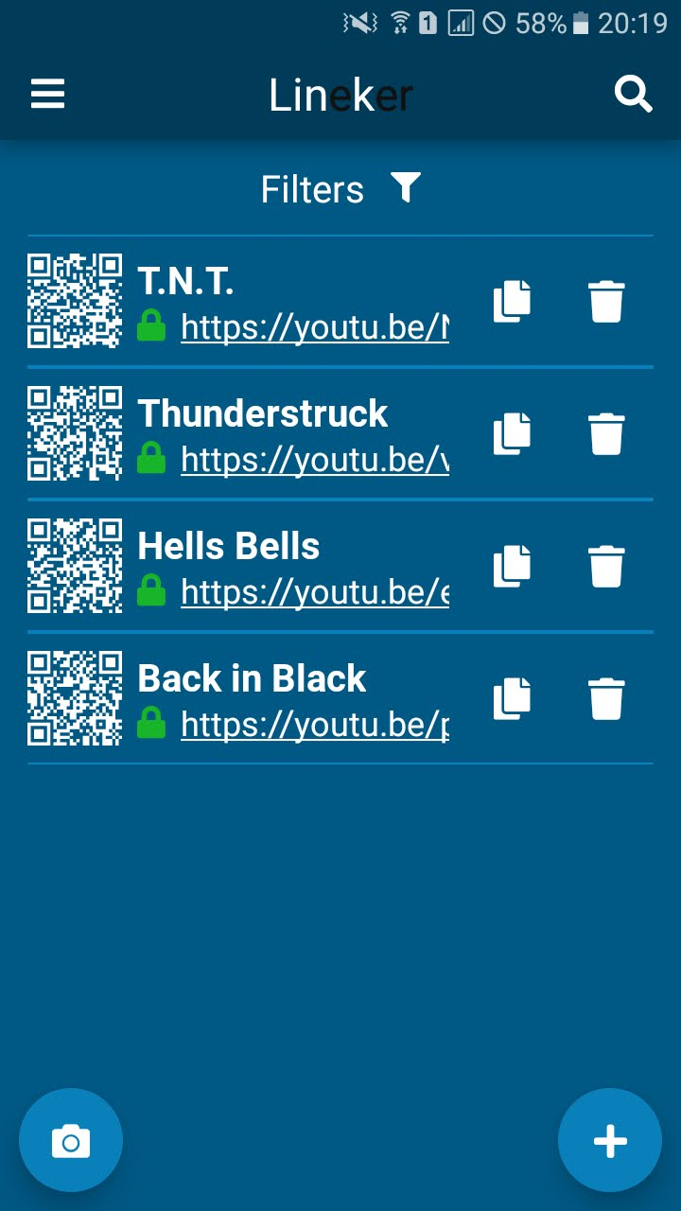
Delete link
Open qr modal
Copy URL to the clipboard
Open URL externally*
* If the URL is valid

Slide 5
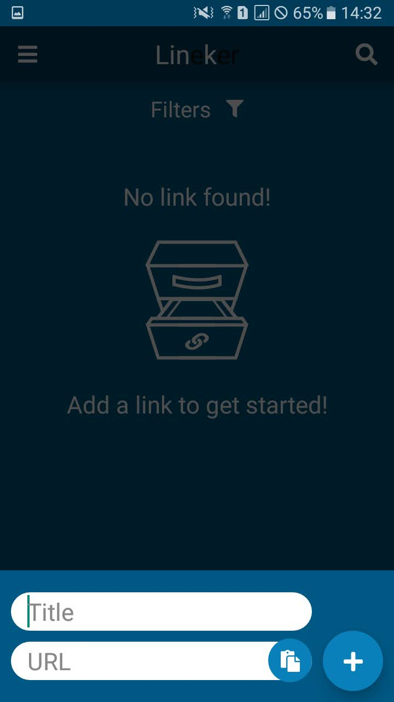

Slide 6
* Link title is optional
Dismiss modal and keyboard on touch
Paste URL from clipboard
Link title input*
Add new link to current filter
Link URL input

Slide 7
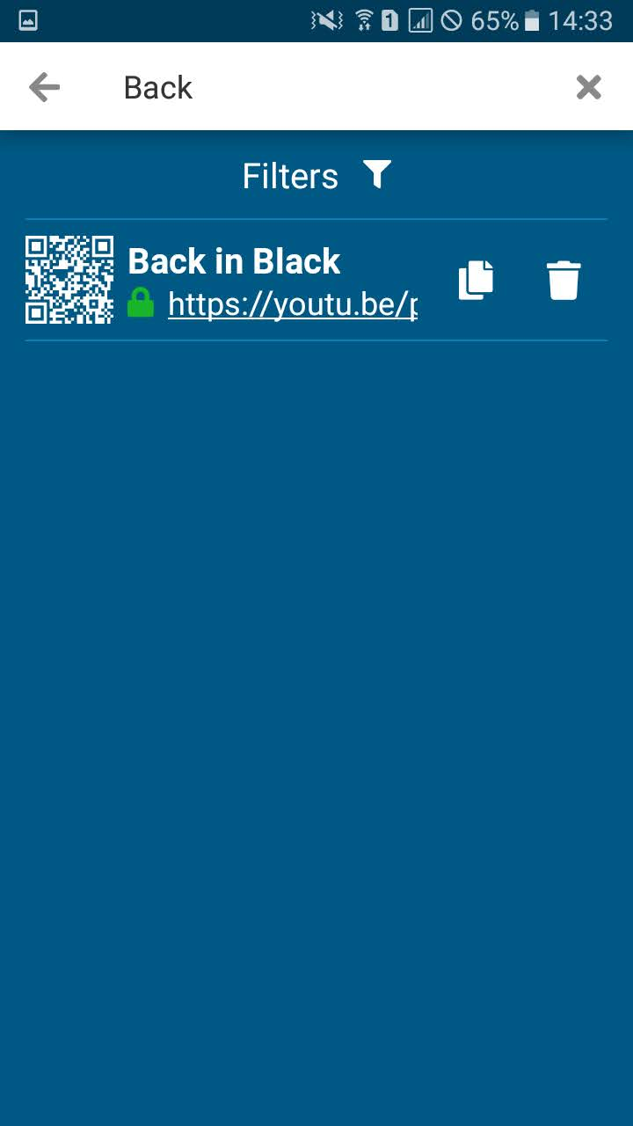

Slide 8
Dismiss search header
Clear search input
Search input*
* Search for a title, URL or date

Slide 9
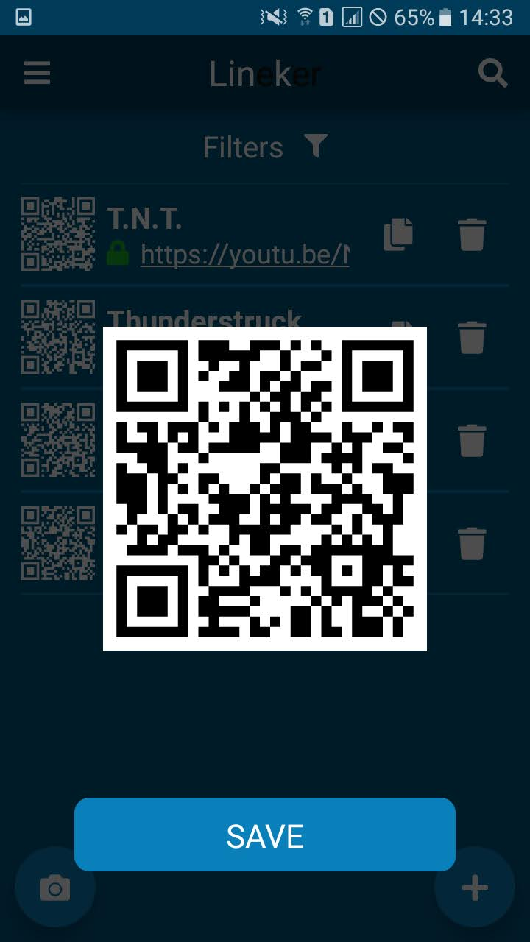

Slide 10
* Requires Media Library permission for storage
Dismiss modal on touch
Save to gallery*

Slide 11
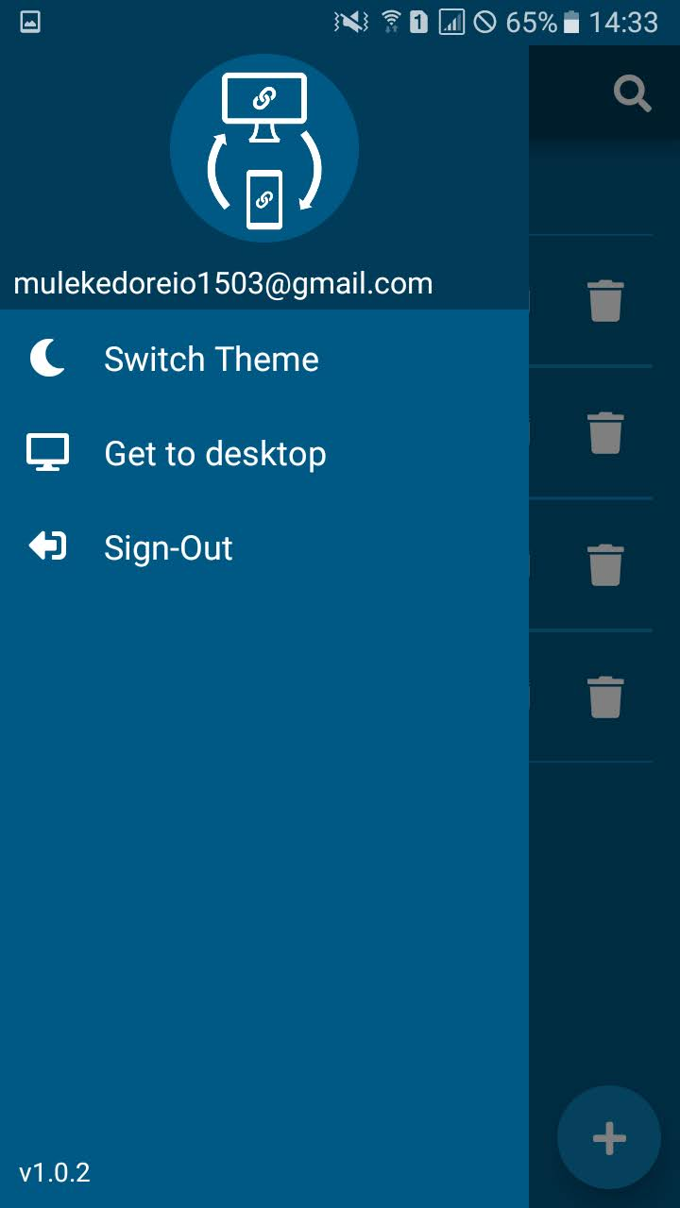

Slide 12
Switch between light and dark theme
Dismiss modal on touch
myemail1337@gmail.com
Open the download page externally
Sign out and go back to the Sign in screen

Slide 13
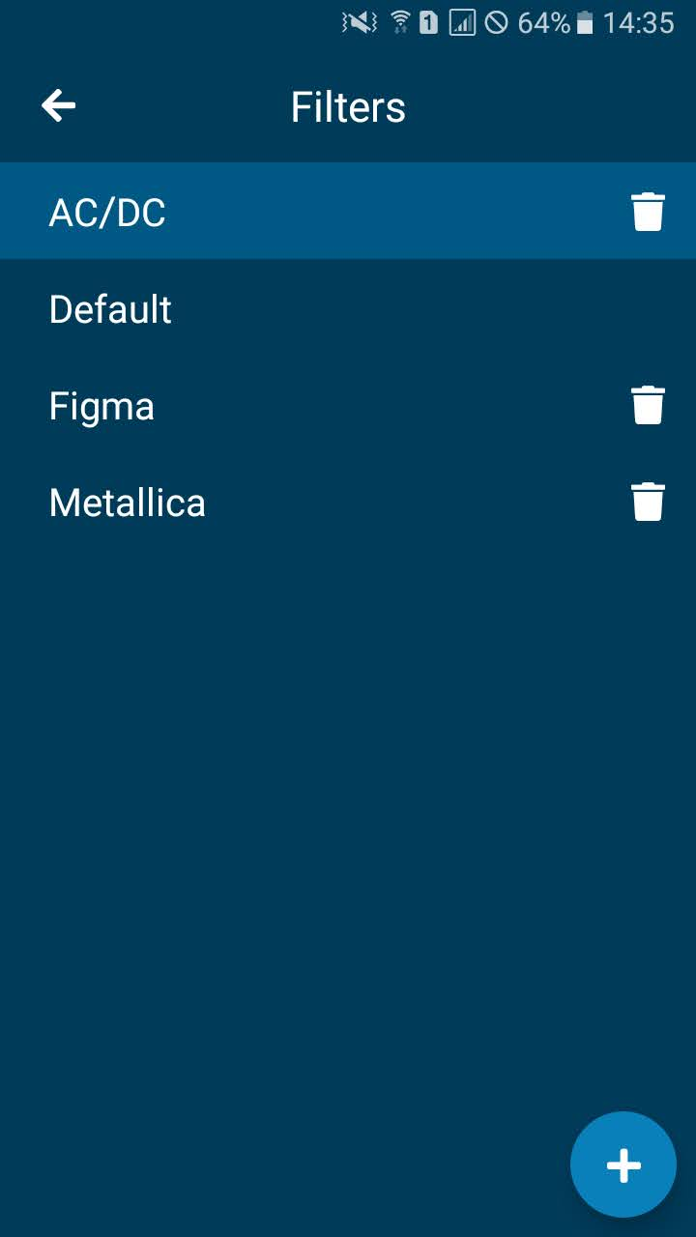

Slide 14
Go back to Main screen
Delete filter
Select current filter
Open add modal

Slide 15
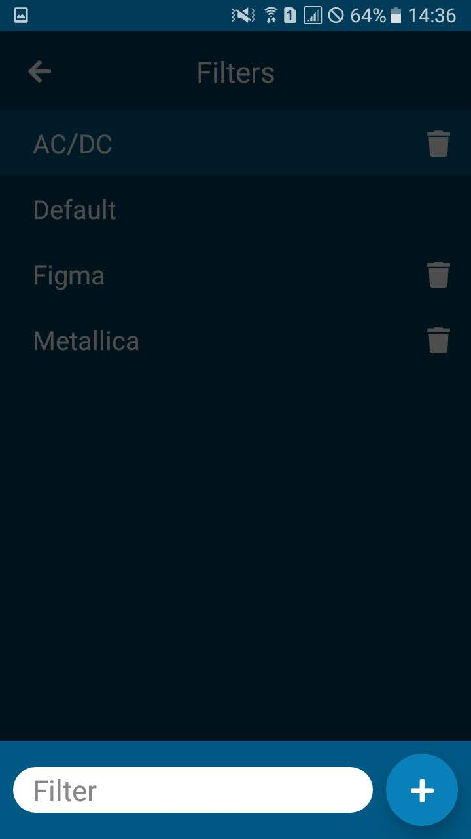

Slide 16
Dismiss modal and keyboard on touch
Filter name input
Add new filter

Slide 17


Slide 18
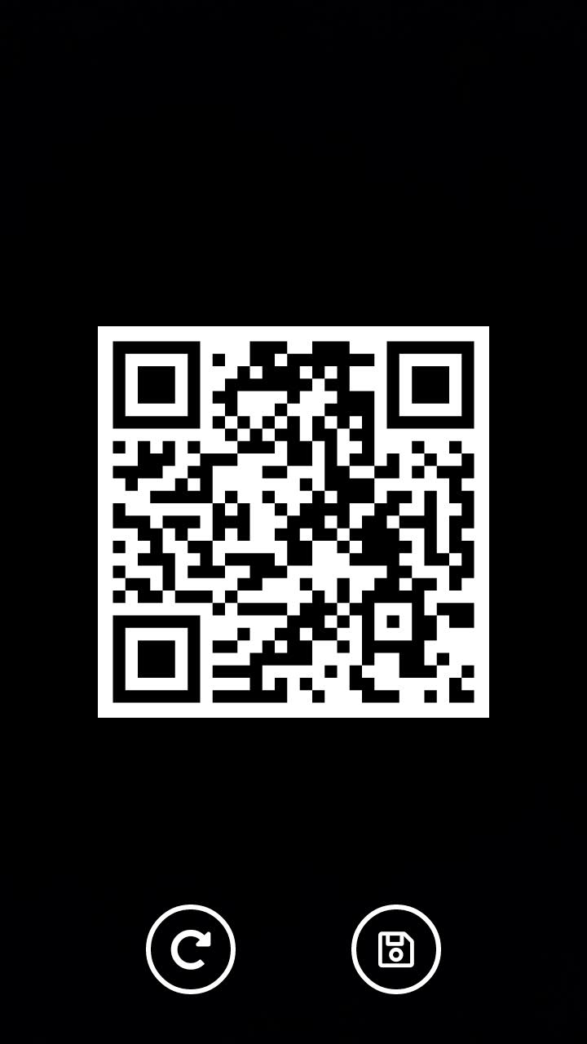
On scan

Slide 19
* Requires Media Library permission for storage
Rescan
Save to gallery*

Slide 20
For the desktop version, see:
https://github.com/Blackoutseeker/Lineker-desktop
© Felips’ Tudio

